Slide 1
Osteopathic Manipulation for common GI disorders
Ryan A. Seals DO
Assistant Professor
UNTHSC Texas College of Osteopathic Medicine

Slide 2
Objectives
Understand relevant anatomy in the gastrointestinal system: viscera, innervations, musculoskeletal relationships
Apply osteopathic principles to your current understanding of GERD and IBS
Devise a plan for appropriate OMT for common GI conditions: GERD and IBS
Bill and code for OMT appropriately
Understand the research supporting OMT for GI conditions

Slide 3
Pre-Test Question
The crura of the diaphragm attach to what anatomic structures?
  The lower thoracic vertebrae
  The upper lumbar vertebrae
  Ribs 11 and 12
  The Sternum

Slide 4
Pre-Test Question
This nerve is primarily responsible for the relaxation of the lower esophageal sphincter?
  Hypoglossal
  Vagus
  Glossopharyngeal
  Phrenic
  Spinal Accessory

Slide 5
Pre-Test Question
A patient presents with complaints of “heartburn”. Where would you expect somatic dysfunction of the spine related to the sympathetic innervation for this patient.
  OA
  T1-4
  T5-9
  T10-L2
  S2-4

Slide 6
Pre-Test Question
Sympathetic nervous system stimulation leads to which of the following actions in the intestines?
  Vasodilation
  Relaxation of sphincters
  Diarrhea
  Decreased persistalsis

Slide 7
Pre-Test Question
Which of the following is a correct ICD-10 code for somatic dysfunction?
  98927
  789.3
  M99.2
  25 modifier
  99213

Slide 8
Question
How often to you use OMT in your current practice?
  A.) Always
  B.) Often
  C.) Occasionally
  D.) Rarely
  E.) Never

Slide 9
Question
If you don’t regularly use OMT, what is the reason you do not use it?
  A.) No time
  B.) Not financially viable
  C.) Lack of comfort performing OMT
  D.) Lack of evidence supporting its use

Slide 10
Tenets of Osteopathy
1). The body is a unit; the person is a unit of mind, body, and spirit.
2). The body is capable of self-regulation, self-healing, and health maintenance.
3). Structure and Function are reciprocally interrelated.
4). Rational treatment is based upon an understanding of the basic principles of body unity, self-regulation, and the inter-relationship of structure and function
Foundations of Osteopathic Medicine. 3rd ed. p 21

Slide 11
Case 1
55-year-old female seen with complaint of “heart burn” especially after lying down with a full stomach. Associated with belching and bloating. Denies hematemesis N/V/D/C or hematochesia. Denies weight loss. OTC Tums offers short lived relief.
FamHX: neg
Past Med Hx: HTN
Meds: Amlodipine, NKDA
Social: Smokes 1ppd, 4 cups Coffee daily.

Slide 12
Physical Exam
BP: 138/88 HR: 68 RR: 16 T: 98.4 BMI: 27
HEENT: nl TM, Pharynx clear, midline uvula and trachea, no lymphadenopathy.
Cardio: Reg 68 no murmurs
Pulm: CTA B/L no W/R/R
Abd: nl BS soft, mild mid epigastric tenderness, no rebound or rigidity.
Structural: AA Rr, Chapman’s reflexes on sternum (pyloris) and anterior left 5th intercostal space (stomach), T5-7 N SrRl, fascial restriction and tenderness noted in epigastric area

Slide 13
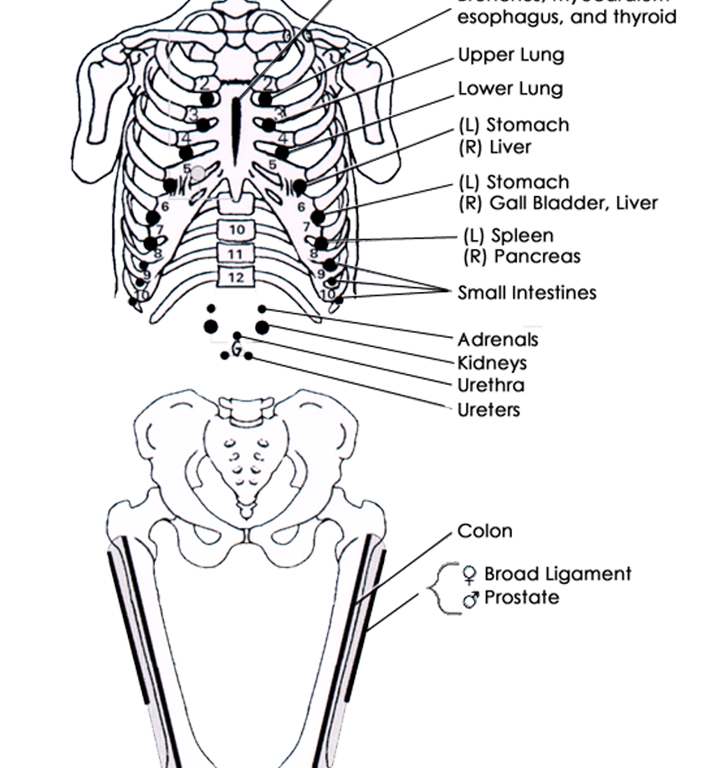
Chapman’s Reflexes
Stomach Points
  Rib 5-6, 6-7
Pyloris
  Sternum
Treatment
  Gentle pressure
  Circular massage

Slide 14
GERD
Incidence
  10% of people have daily heartburn
  44% of people have symptoms once a month
  17% of all GI diagnoses are GERD
  Second most costly GI disease

Slide 15
GERD Symptoms
Heartburn is the classic symptom of GERD
  Burning feeling, rising from the stomach and lower chest and radiating toward the neck
  Usually occurs after large meals
  Worse when lying supine
  Severity of symptoms don’t always correlate with degree of esophageal damage
  Symptoms can be caused by acid reflux, bile reflux, and mechanical stimulation of the esophagus
Sleisenger and Fordtran's Gastrointestinal and Liver Disease , Ninth Ed.
Notes:
Sleisenger and Fordtran's Gastrointestinal and Liver Disease , Ninth Edition
Mark Feldman, Lawrence S. Friedman, and Lawrence J. Brandt
Chapter 118, 2091-2104.e6
Copyright © 2010

Slide 16
Pathophysiology
Lower Esophageal sphincter (LES)
  Distal 3-4 cm of esophagus is contracted at rest
    Upper half usually located ABOVE diaphragm
    Lower half usually located BELOW diaphragm
  Lies within hiatus created by right crura of the diaphragm
  Anchored by the phrenoesophageal ligament (PEL)

Slide 17
Pathophysiology
Lower Esophageal sphincter (LES) pressure
  Complex and mediated by many factors
  Hormones and gastrointestinal peptides
  Foods, alcohol, nicotine
  Drugs and medications
Transient relaxation of Lower Esophageal Pressure NOT always associated with GERD
  Mediated via vagus nerve stimulated from gastric distension
  Stretch response in stomach- food bolus vs. mechanical
Contributions of hiatal hernia to GERD remain controversial

Slide 18
GERD Diagnosis & Treatment
Diagnosis
  Often done with trial of acid suppression medication
    Improvements of 50% or more support GERD diagnosis
  pH monitoring
Treatment
  Lifestyle modifications
    Smaller meals, avoid carbonated beverages, upright posture
  Acid suppression therapy
  Surgery
  OMT

Slide 19
Proton Pump Inhibitors
One of the most common class of prescribed drugs
Difficult to discontinue because of rebound increase in acid production
Been associated with
  Increase fractures in post-menopausal women
  Increased C. difficle infections
  Increased risk for pneumonia
  Interactions with other medications (e.g. clopidogrel)
  Low Magnesium levels
  Heart attacks*
www.fda.gov
med.stanford.edu*

Slide 20

Osteopathic Considerations

Slide 21
Biomechanical
Right crura of the diaphragm
  Attaches L1-L3
  Fascial connections to rib 12
Tension on the longitudinal muscle layer of esophagus
  Phrenoesophageal ligament
  Connection to transversalis fascia

Slide 22
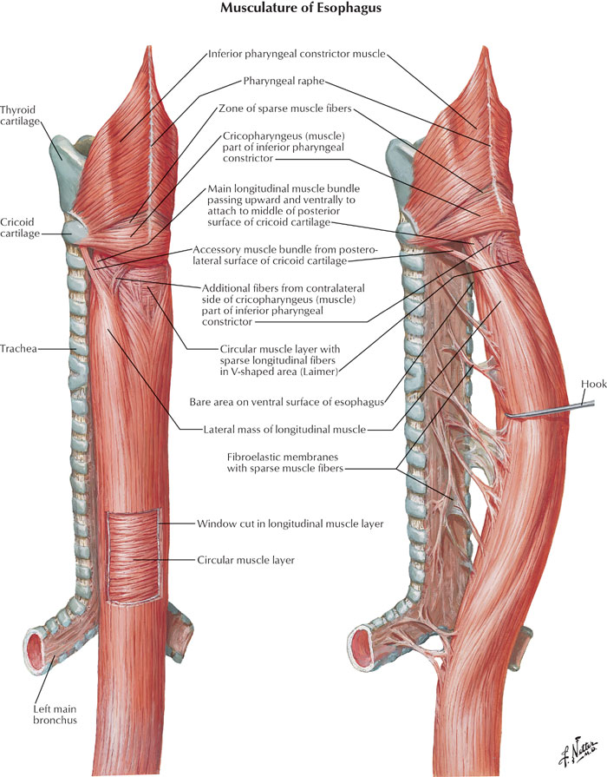

Slide 23
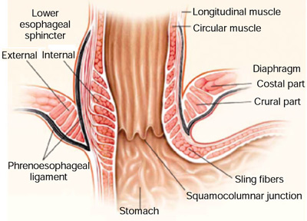
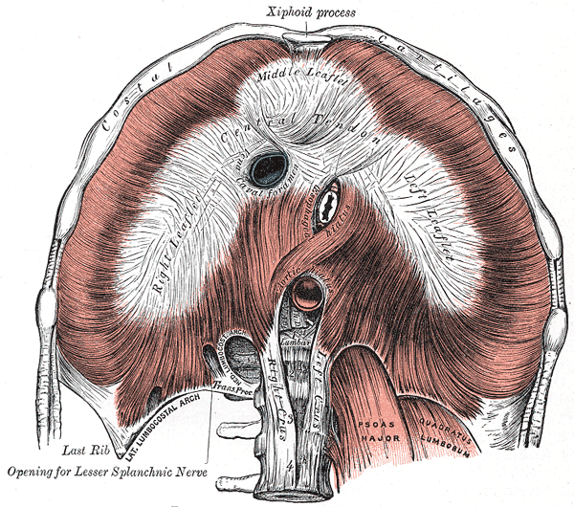
Gray’s Anatomy

Slide 25
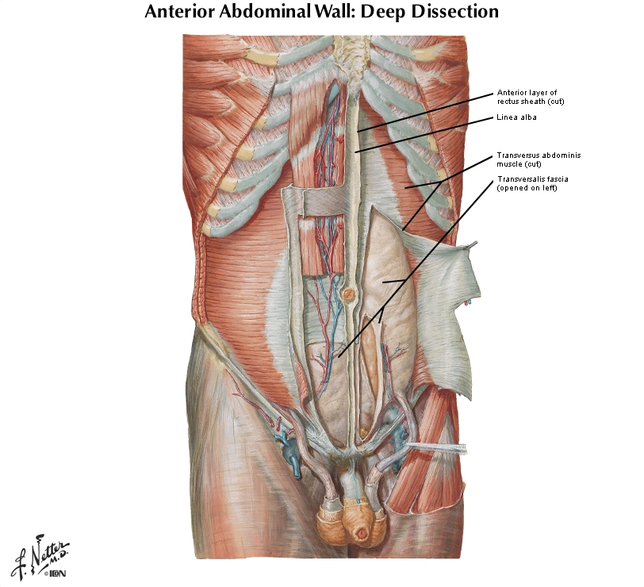

Slide 26
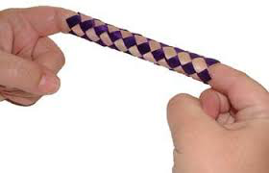
GERD: Osteopathic Thoughts
Longitudinal Muscle
  Contracts with vagal stimulation
    1.5 cm of shortening
  When this muscle contracts LES relaxes
    Because of traction on phrenoesophaeal ligament
      Primarily formed from transversalis fascia
    Traction on PEL can produce GERD symptoms
      Mechanical tension on the esophagus
Vagal tone
  Can increase acid secretion
  Relaxes lower esophageal sphincter
http://www.esophagushoncho.com

Slide 27
Autonomic Nervous System- Effects on the Gastrointestinal system
Sympathetics
Increased tone causes:
Decreased motility in the gut : constipation, distention
Parasympathetics
Increased tone causes:
Increases motility and peristalsis
Contraction of the sphincters (including LES)
Vasoconstriction
Decreased mucosal defenses in the stomach
Increases secretions
Vasodilation
Relaxation of sphincters
From T5-T9
From Vagus
Foundations of Osteopathic Medicine. 3rd ed. P 146

Slide 28
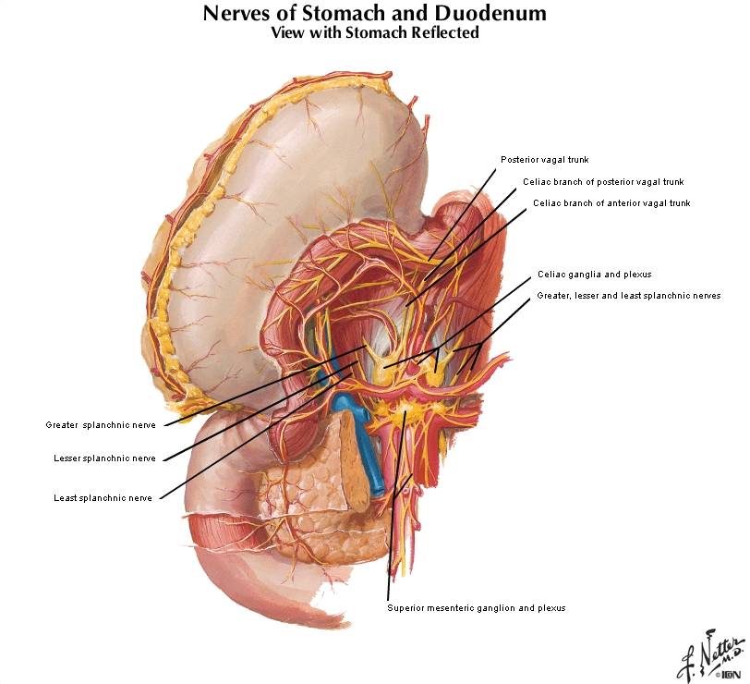
Greater Splanchnics arise from T5-T9

Slide 29
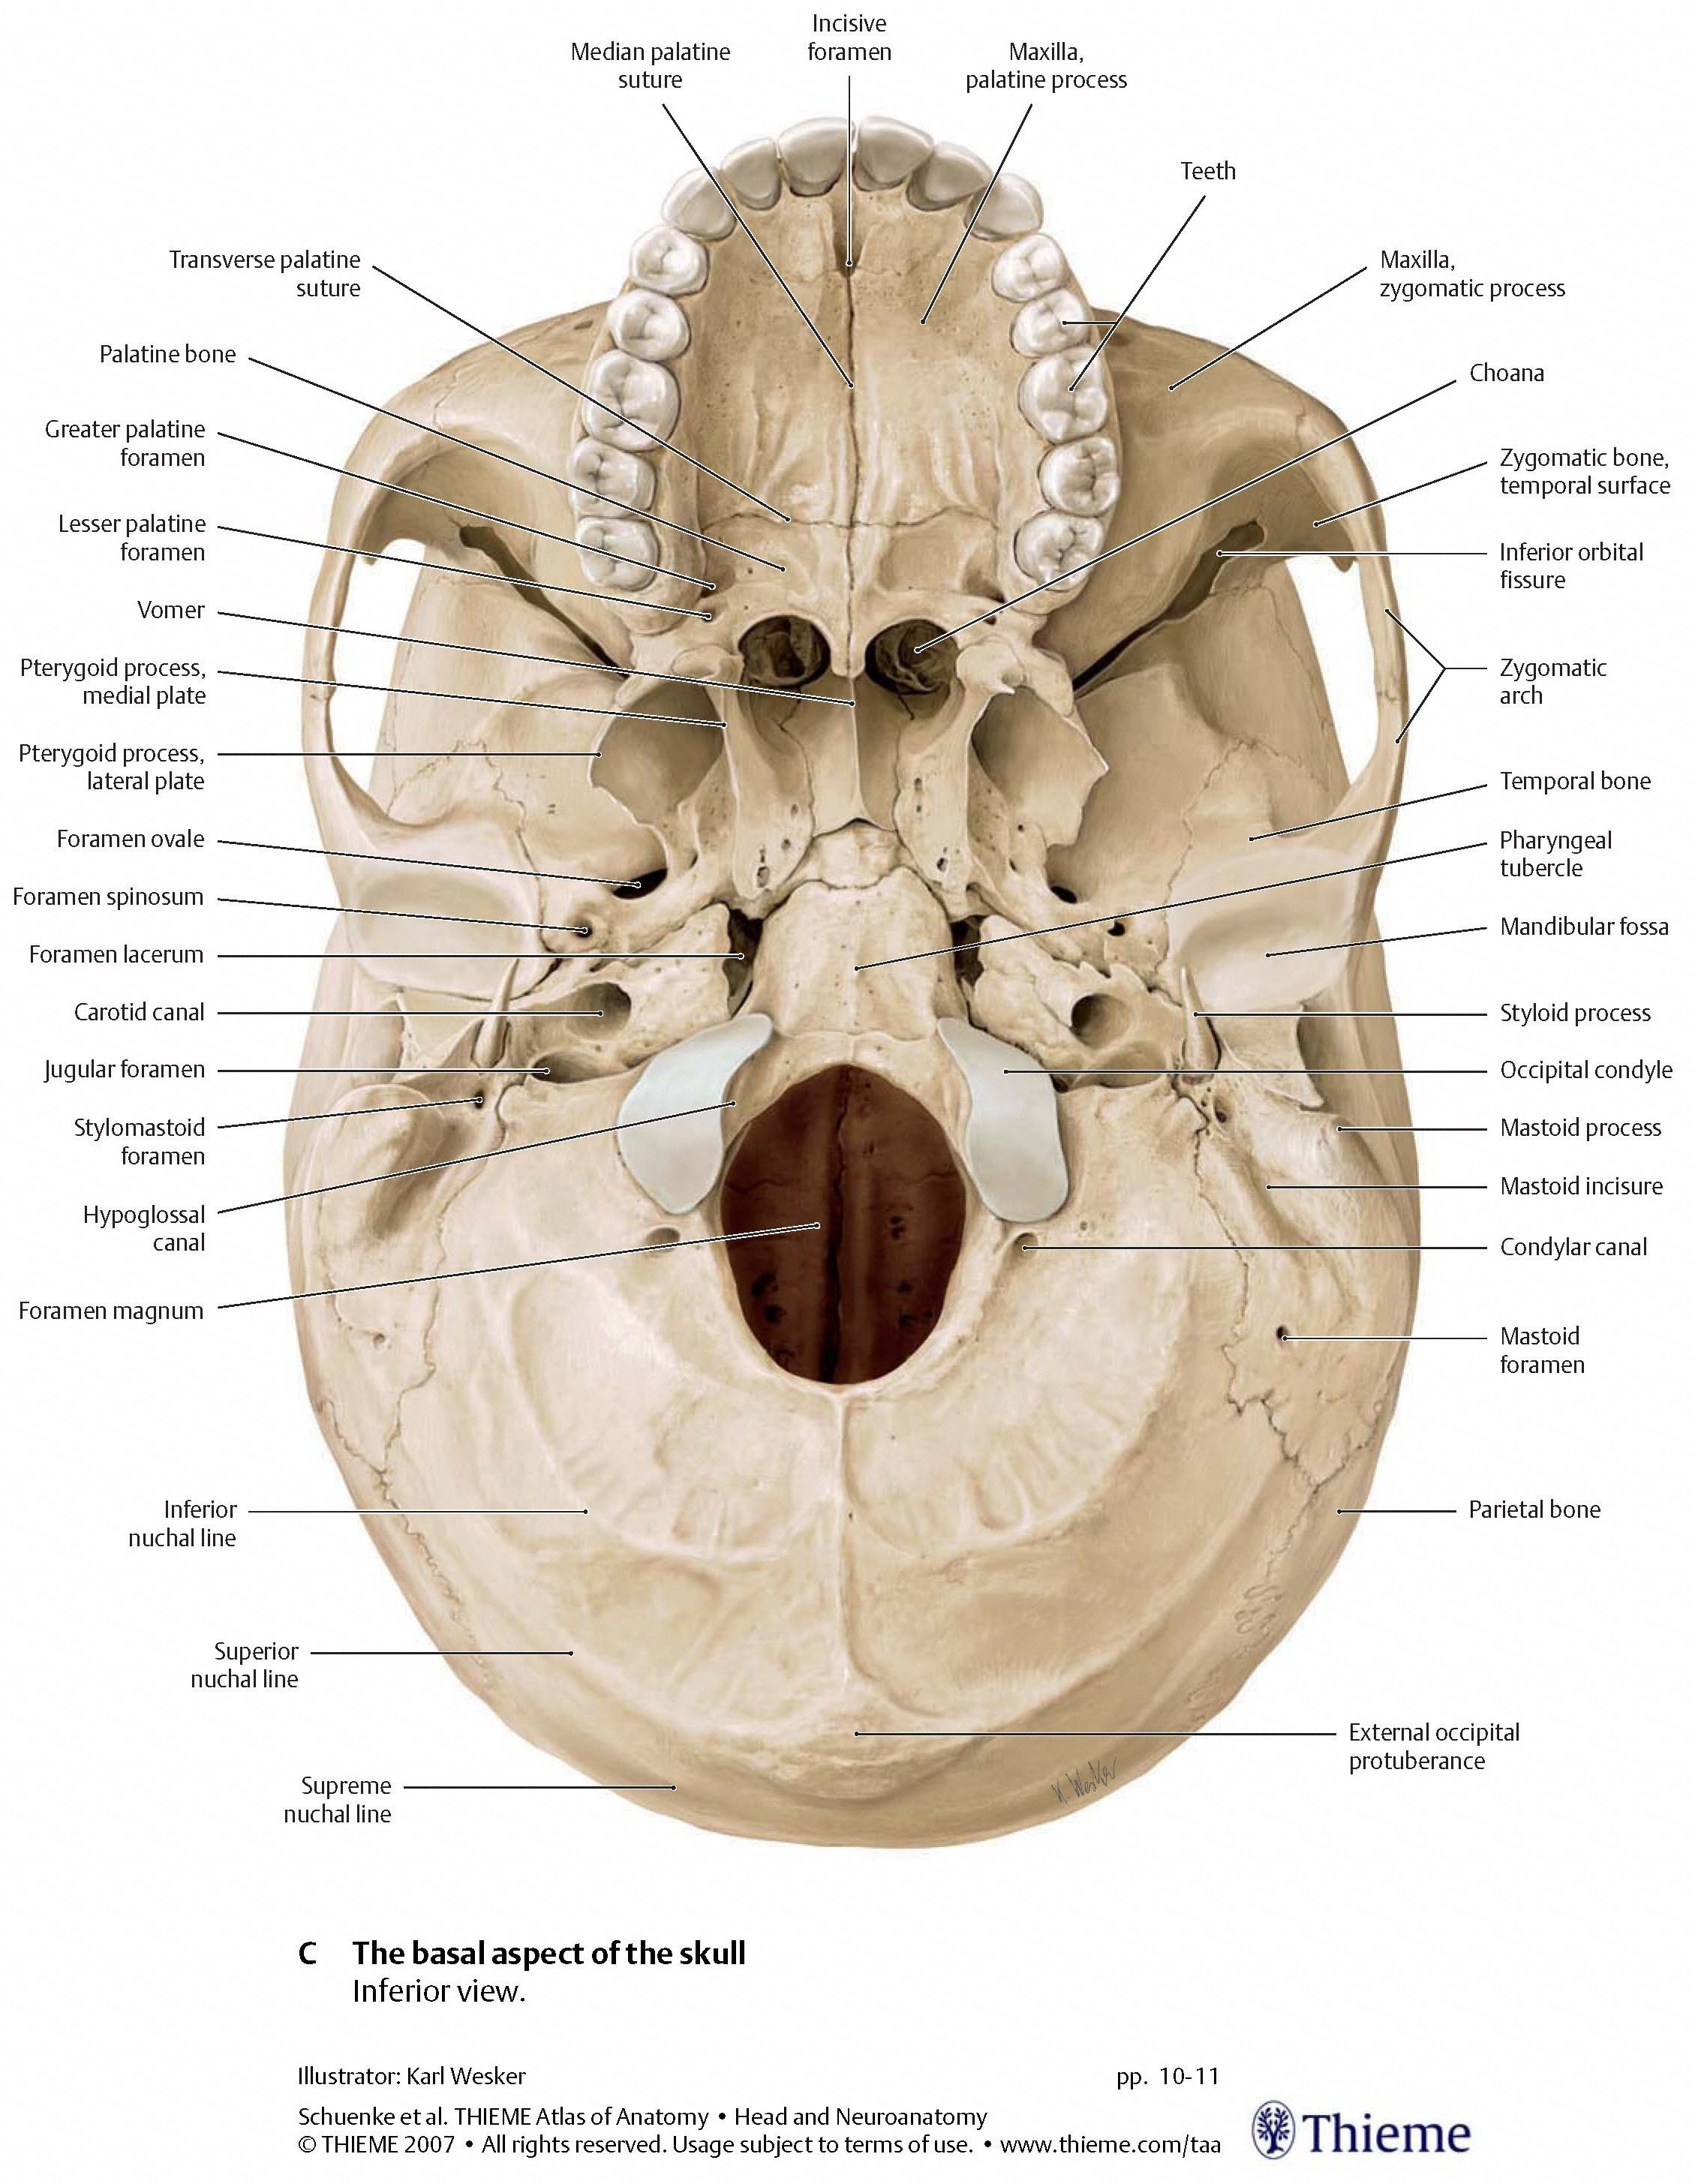
Jugular Foramen
Thieme

Slide 30
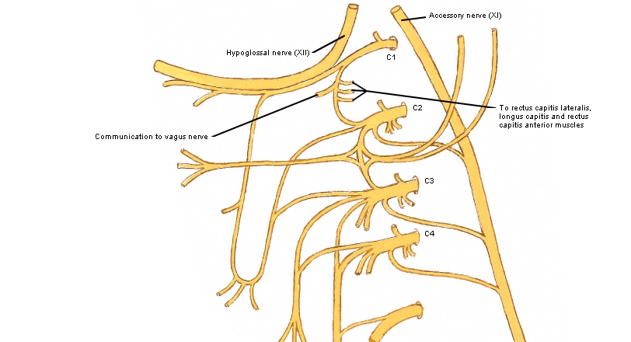
Vagus relationship to cervicals
Netter’s

Slide 31
Lab 1: Part A (30 minutes)
Diagnose
  Chapman’s Points
  OA (Occipitomastoid suture if you have cranial experience)
  T5-T9, L1-3
  Longitudinal traction on the esophagus
Treatment
  OA or Occipitomastoid suture
    BLT or Muscle Energy
    Can also do sub-occipital inhibition
  Treat T5-T9, L1-3
    Muscle Energy
    HVLA
    Inhibitory Pressure

Slide 32
Chapman’s Reflexes
Stomach Points
  Rib 5-6, 6-7
Pyloris
  Sternum
Treatment
  Gentle pressure
  Circular massage

Slide 33
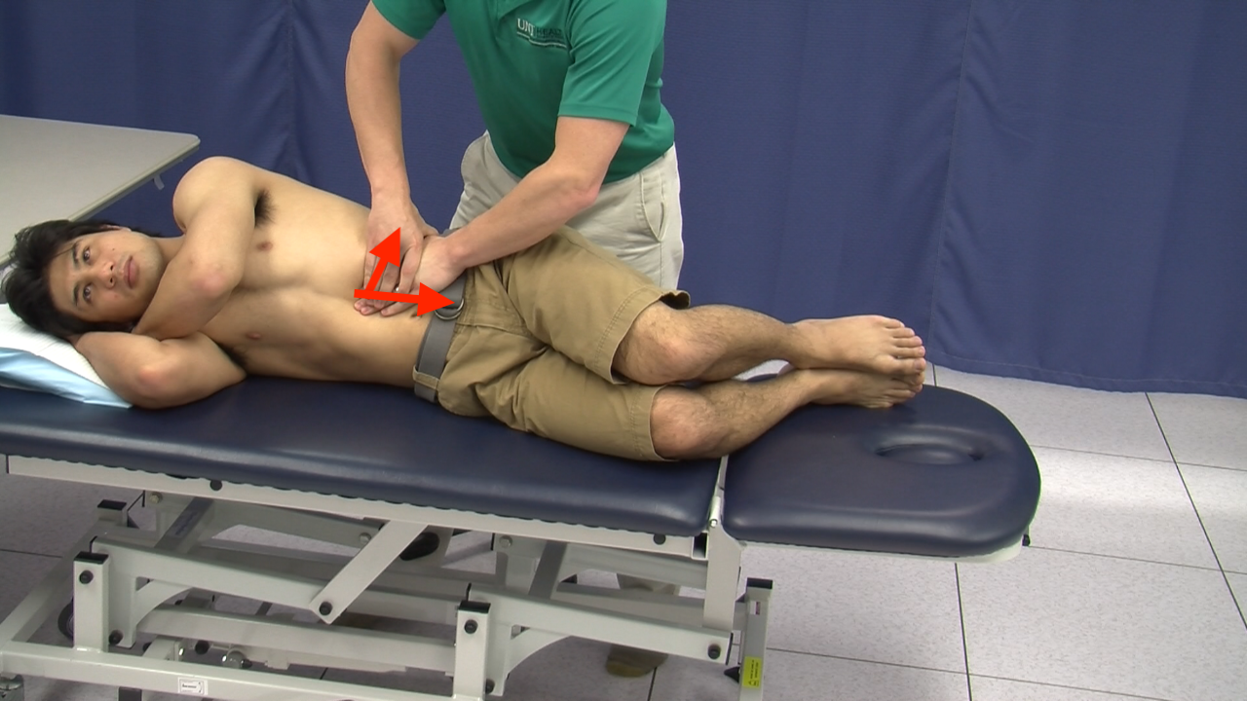
Gastric Traction

Slide 34
Lab 1: Part B (30 minutes)
Treat rib 12 with BLT
  Linea alba and ganglia release
  Chapman’s reflexes for stomach
Reassessment
  Esophageal traction (treat by holding traction if still restricted)
  Chapman’s points

Slide 35
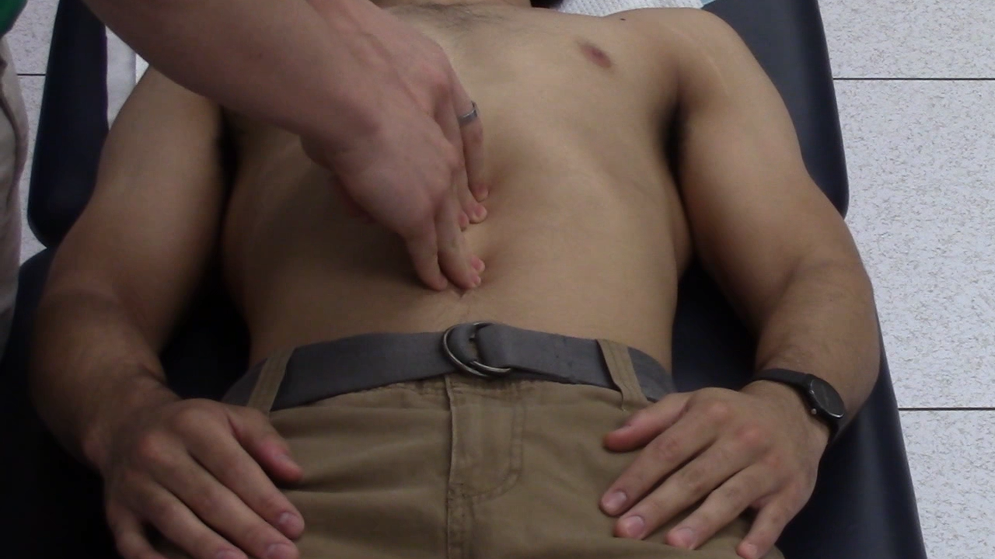
Superior Linea Alba

Slide 36
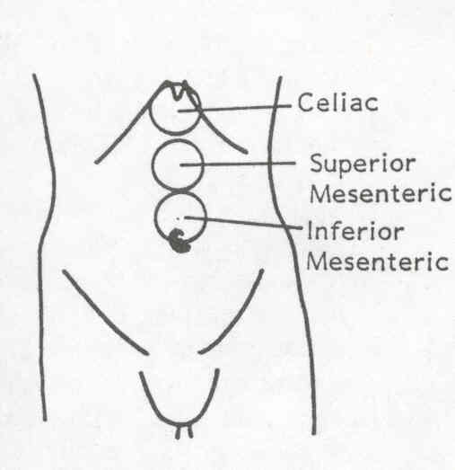
Celiac Ganglion
Inhibition of Ganglia
Innervation of upper GI--nerve roots
Break the hyperexcitation
Kuchera, Kuchera. Osteopathic Considerations in Systemic Dysfunction.

Slide 37
Chapman’s Reflexes
Stomach Points
  Rib 5-6, 6-7
Pyloris
  Sternum
Diagnosis
  Feels like a pea sized area of congestion
  Usually tender

Slide 38
Reassess Gastric Traction

Slide 39
Lab 1: Part B (30 minutes)
Treat rib 12 with BLT
  Linea alba and ganglia release
  Chapman’s reflexes for stomach
Reassessment
  Esophageal traction (treat by holding traction if still restricted)
  Chapman’s points

Slide 40
GERD: Osteopathic Treatment
Mechanical influences of gastroesphageal junction
  Right crura (upper lumbar vertebrae, diaphragm, 12th rib)
  Linea alba and transversalis fascia
Nervous influences from celiac plexus, vagus (OA, C1, C2), and T5-9
I have given you multiple areas to look for dysfunction, but treat the worst dysfunctions as you have time
  Even 1-2 techniques to key dysfunctions can make a BIG difference!
Notes:
Hiatal hernia or with surgical treatment of GERD that ruptures PEL relieves pain
Surgeries that shorten esophagus cause GERD even if they don’t touch GE junction
Surgeries that lengthen esophagus relieve GERD symptoms

Slide 41
Case Summary
Assessment- Established office visit (99213-9214)
  GERD (530.81)
  Hypertension (401.9)
  Somatic Dysfunction
    Cervicals 789.1
    Thoracics 789.2
    Abdomen 789.9
Plan
  Lifestyle modifications: decrease coffee intake, sit upright after meals
  Consider changing Amlodipine
  Osteopathic manipulation to 3-4 body regions (CPT 98926)

Slide 42
OMM codes
Somatic Dysfunction
Osteopathic Manipulation
  Cranial- 789.0 (M99.00)
  Cervical- 789.1 (M99.01)
  Thoracic- 789.2 (M99.02)
  Lumbar- 789.3 (M99.03)
  Sacrum- 789.4 (M99.04)
  Hip/Pelvis- 789.5 (M99.05)
  Lower Extremity- 789.6 (M99.06)
  Upper extremity- 789.7 (M99.07)
  Rib- 789.8 (M99.08)
  Abdomen/other- 789.9 (M99.09)
  98925: 1-2 body regions
  98926: 3-4 body regions
  98927: 5-6 body regions
  98928: 7-8 body regions
  98929: 9-10 body regions
  25 modifier on E&M code for separately identifiable service

Slide 43
Osteopathic Research
Changes in LES pressure noted after OMT
  Da Silva, et al. Increase of lower esophageal sphincter pressure after osteopathic intervention on the diaphragm in patients with gastroesophageal reflux. Diseases of the Esophagus. July 2013; 26:5; 451-456.
Improvements in quality of life questionnaire for GERD after treatment with OMT
  Deniz, et al. Qualitative Evaluation of Osteopathic Manipulative Therapy in a Patient With Gastroesophageal Reflux Disease: A Brief Report. J Am Osteopath Assoc. March 1, 2014; 114:3; 180-188

Slide 44
Break!

Slide 45
Case 2
A 28 year old female presents to your office with complaints of abdominal pain. She states the pain is there most days and is impacting her daily life. The pain has been going on for a year now. She denies any blood in her stools, denies weight loss. It seems to get better with bowel movements. She states sometimes she feels constipated, while other times she has loose and frequent stools. The symptoms seem to be worse with stress. She has had a colonoscopy that was normal and is negative for Celiac disease.

Slide 46
Case 2
On exam her abdomen is soft and mildly tender diffusely to deep palpation. Bowel sounds are normoactive. Negative rebound tenderness. Chapman’s points are found for the intestines and colon and are negative for uterus and ovary. Structural exam reveals tissue texture changes T10-L2 bilaterally. L/L Sacral torsion. Tenderness and restriction are noted along the linea alba. AA rotated left. Diaphragm restriction.

Slide 47
Chapman’s Reflexes
Small Intestine
  8-9,9-10, 10-11
Colon
  Anterolateral thigh
Treatment
  Gentle pressure
  Circular massage

Slide 48
IBS
Definition: A gastrointestinal disorder characterized by presence of abdominal discomfort or pain associated with disturbed defecation.
More common in younger individuals and in women
Important to rule out more serious pathology by assessing for red flags such as weight loss, bloody stools, etc.
Sleisenger and Fordtran's Gastrointestinal and Liver Disease , Ninth Ed.

Slide 49
IBS: ROME III basic criteria
Recurrent abdominal pain or discomfort** at least 3 days per month in the last 3 months, associated with 2 or more of the following:
1. Improvement with defecation
2. Onset associated with a change in frequency of stool
3. Onset associated with a change in form (appearance) of stool
*Criteria fulfilled for the last 3 months with symptom onset at least 6 months prior to diagnosis.
**Discomfort means an uncomfortable sensation not described as pain. In pathophysiology research and clinical trials, a pain/discomfort frequency of at least 2 days a week during screening evaluation for subject eligibility.
***Criteria have not been validated and may not exclude other pathology
Notes:
www.romecriteria.org
Pencil stools

Slide 50
Pathophysiology
Abnormal gut motility
  Increased contraction with meals/stress, altered transit times
Stress
  Particularly childhood stressors and abuse
Visceral hypersensitivity
  Increased pain with balloon distension of rectum
Low-grade inflammation
  Infections, abnormal flora, bile, food antigens (gluten)
  Increased T-lymphocytes in mucosa
Sleisenger and Fordtran's Gastrointestinal and Liver Disease , Ninth Ed.

Slide 51
Autonomic Nervous System- Effects on the Gut Motility
Sympathetics
Increased tone causes:
Decreased motility in the gut : constipation, distention
Parasympathetics
Increased tone causes:
Increases motility and peristalsis
Contraction of the sphincters
Vasoconstriction
T10-L2 innervates the intestines
Increases secretions
Vasodilation
Relaxation of sphincters
Vagus innervates down to splenic flexure of colon
S2-4 innervates distal colon
Notes:
Foundations. Page 146.
Grays. P 1004 “Sympathetic nerves may control tracheobronchial blood vessels, but innervation of human airway smooth muscle by sympathetic-adrenergic fibers has yet to be convincingly demonstrated.”

Slide 52
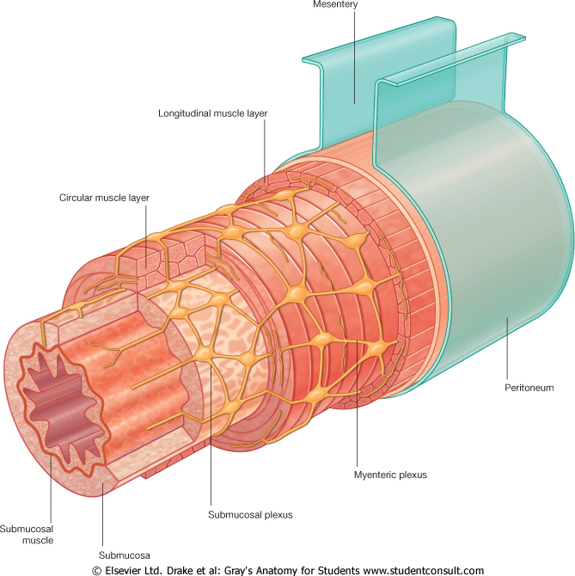
Enteric Nervous System
Often considered “second brain”
  Contains 90% of serotonin in the body
  Contains 50% of dopamine in the body
Related with Autonomic nervous system
  However still functions even if vagus is cut

Slide 53
Stress
The body is a unit- mind, body, and spirit
  40-94% of patients with IBS have coexisting depression, anxiety, and somatization
  History of sexual, physical, or emotional abuse is more frequent in patients with IBS
  Gastric suction at birth- 3 times more likely to have hospitalization for unexplained abdominal pain
Think of hypothalamic-pituitary-adrenal axis and its response to stress
  Enteric nervous system has many neurotransmitters
Psychological interventions including CBT very effective
  NNT 4
  Gut 2009 Mar;58(3):367
Sleisenger and Fordtran's Gastrointestinal and Liver Disease , Ninth Ed.

Slide 54
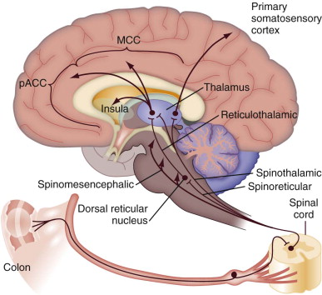
Hypersensitivity
PET and fMRI have shown alteration in brain response to visceral stimulation in those with IBS
Abnormal modulation can occur at the visceral, spinal, or central level
Mechanical and inflammatory stimuli to tissues can cause increased sensitization or facilitation

Slide 55
Putting it together
Neurologic influences
  Check OA, AA, Sacrum (Parasympathetic influences)
  Linea alba and mesenteric ganglia inhibition
Inflammation
  Lymphatic drainage of gut mesentery
  Treat diaphragm and thoracic outlet
Behavioral
  Educate patient on diet and emotional connections
  Consider referral for CBT or counseling

Slide 56
Lab 2: Part A (20 minutes)
Review your abdominal exam
  Check for Mesenteric restriction
Diagnose Chapman’s reflexes
Screen T10-Sacrum
  Treat with technique of your choice
  Lumbosacral Decompresion or Sacral Rocking

Slide 57
Chapman’s Reflexes
Small Intestine
  8-9,9-10, 10-11
Colon
  Anterolateral thigh
Diagnosis
  Feels like a pea sized area of congestion
  Usually tender

Slide 58
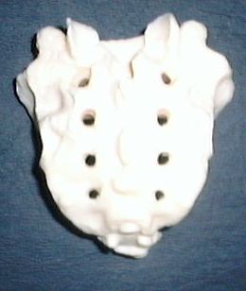
Sacral Rocking
Place the fingertips of one hand at the ILA of the sacrum
Place the fingertips of the other hand at the ipsilateral sacral base
Exert alternate pressure in an anterior direction with fingertips
S2-4 supply parasympathetics to the distal colon

Slide 59
Lab 2: Part B (30 minutes)
Treat Chapman’s reflexes
  Small and large intestine
Treat Diaphragm and Thoracic Inlet
Mesenteric Release

Slide 60
Respiratory/Circulatory
Approach:
Clearing Inflammation

Slide 61
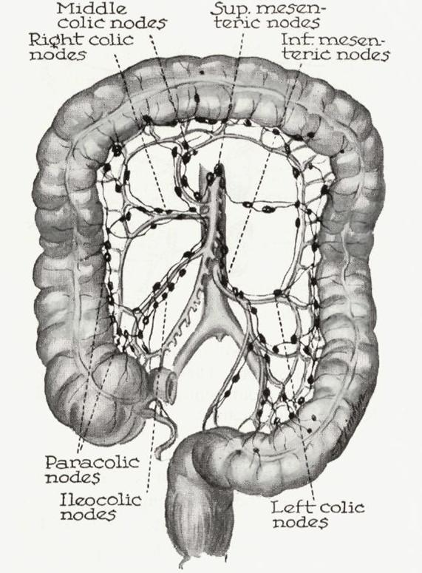
Lymphatic Drainage

Slide 62
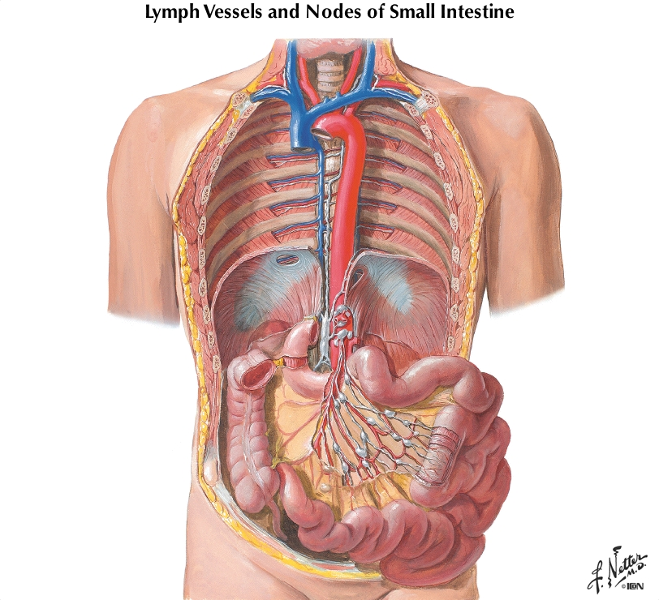
Thoracic Duct

Slide 63
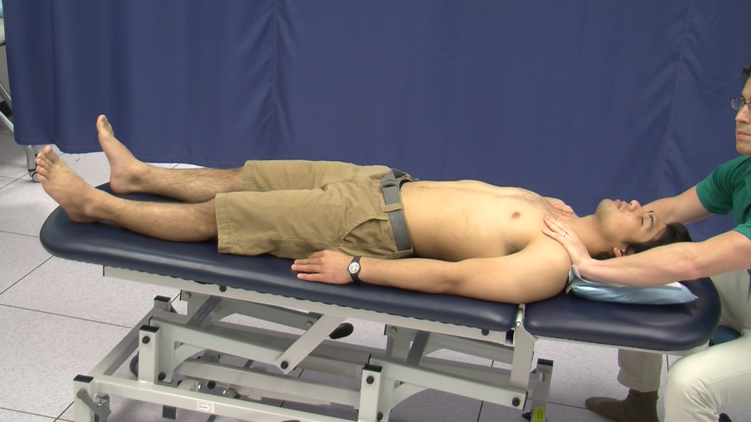
Thoracic Inlet- Myofascial Release

Slide 64
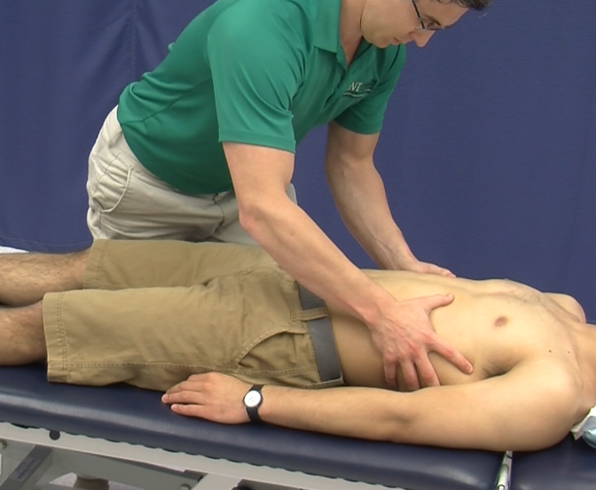
Diaphragm- Myofascial Release

Slide 65
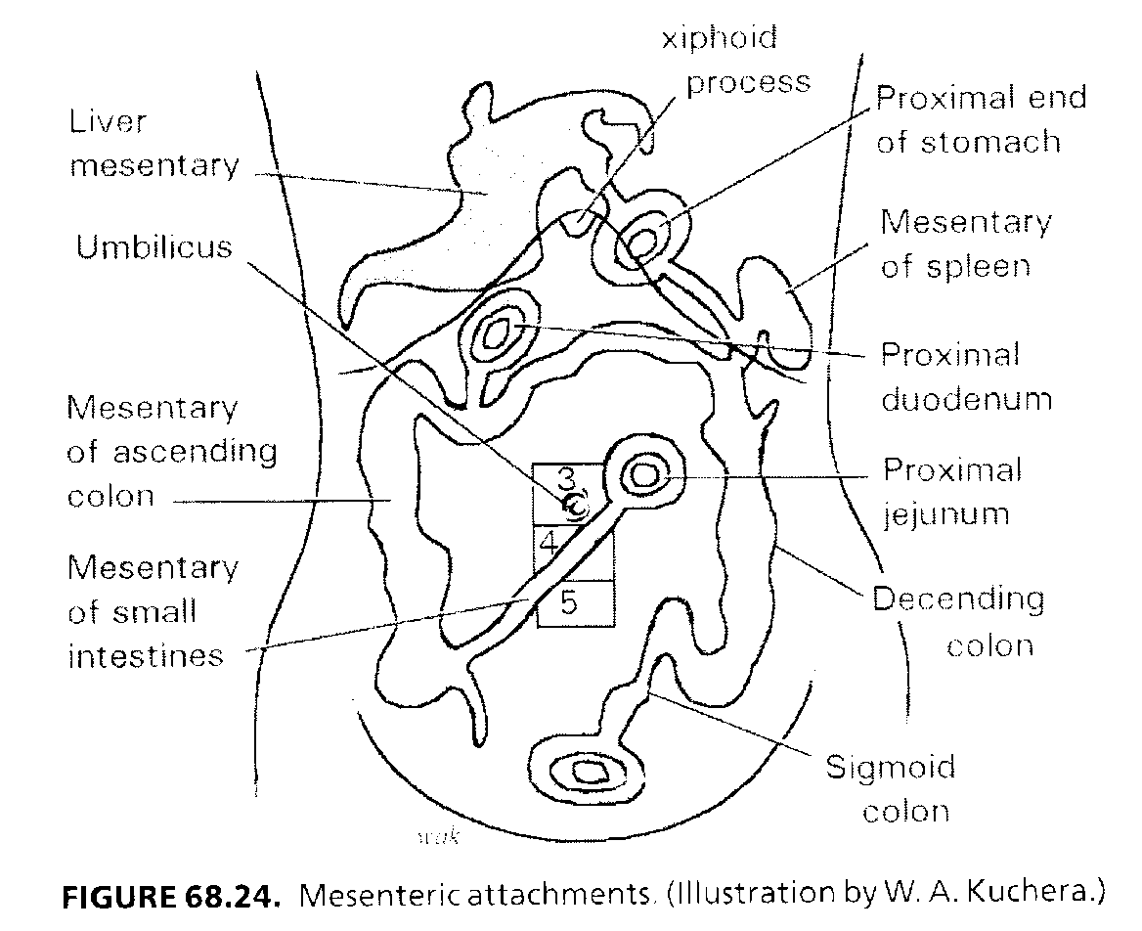
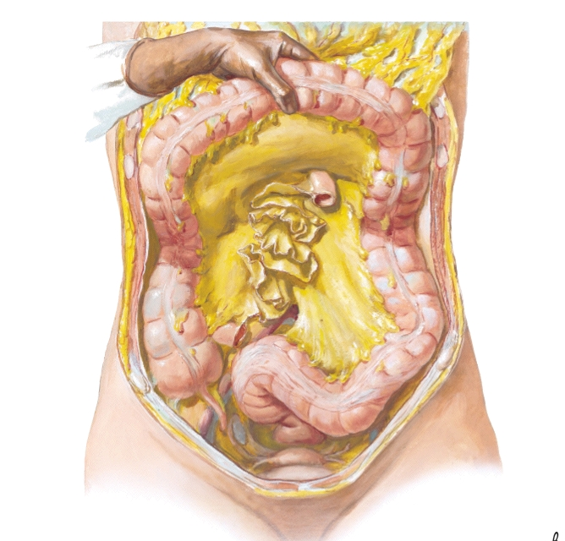
Mesenteric attachments
Netter
Foundations of Osteopathic Medicine. 3rd ed.

Slide 66
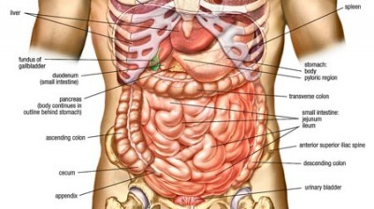

Slide 67
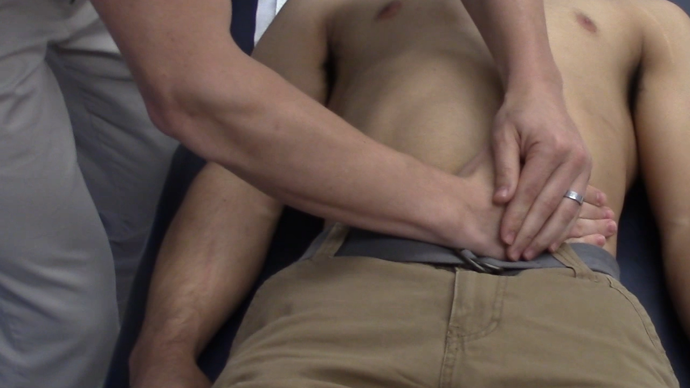
Mesenteric Lift-Small Intestine

Slide 69
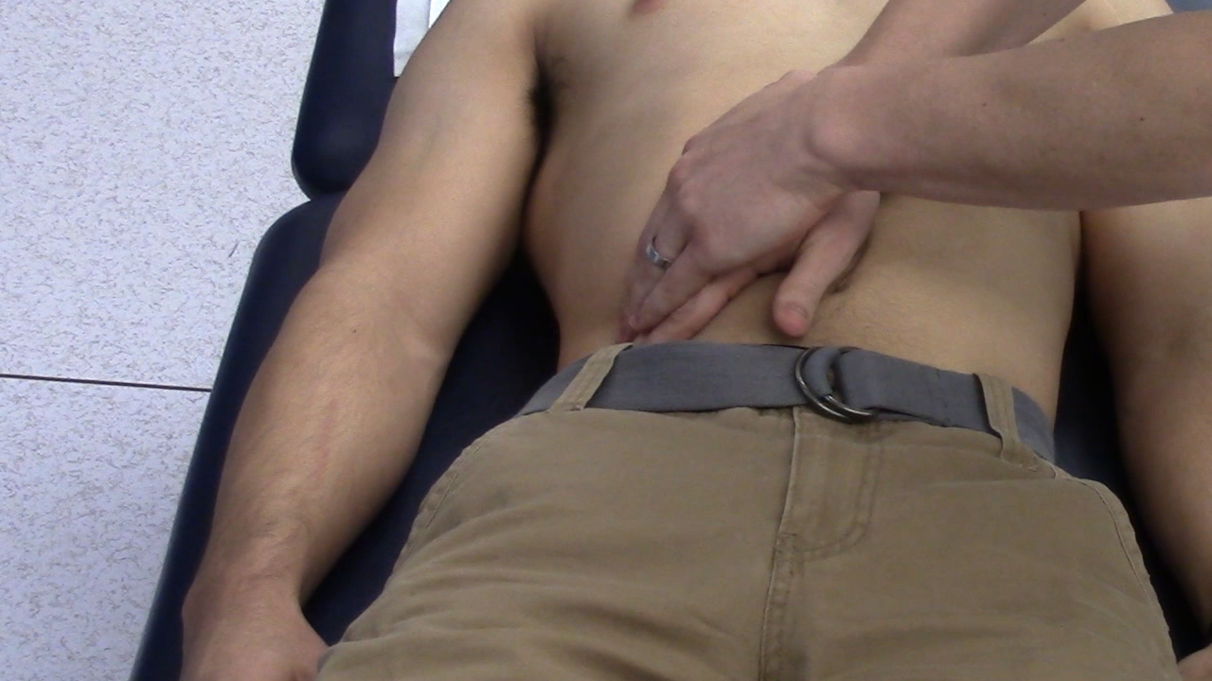
Mesenteric Lift-Ascending Colon

Slide 71
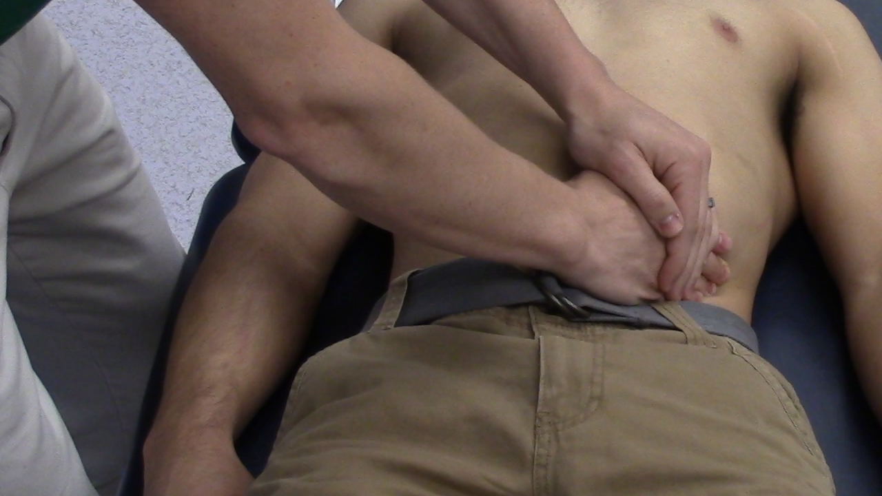
Mesenteric Lift-Descending Colon

Slide 72
Mesenteric attachments
Netter
Foundations of Osteopathic Medicine. 3rd ed.

Slide 73
Treatment tips
Use the ulnar side of your hand to contact the abdomen
  Don’t poke or press too quickly
Slowly let your hands sink down through the abdominal wall to contact the viscera
Gently move the intestines toward the midline until you just feel a subtle restriction in your hands
Wait for there to be a softening of the restriction and allow the stretch to occur.
Release tension slowly

Slide 74
Lab 2: Part B (30 minutes)
Treat Chapman’s reflexes
  Small and large intestine
Treat Diaphragm and Thoracic Inlet
Mesenteric Release

Slide 75
Lab 2: Part C (20 minutes)
Recheck spine
Recheck abdomen for tension in linea alba and mesentery
Recheck all Chapman’s Reflexes
Treat any remaining

Slide 76
Neurologic Approach

Slide 77
Celiac Ganglion
Inhibition of Ganglia⁶
Innervation of upper GI--nerve roots
Break the hyperexcitation

Slide 78
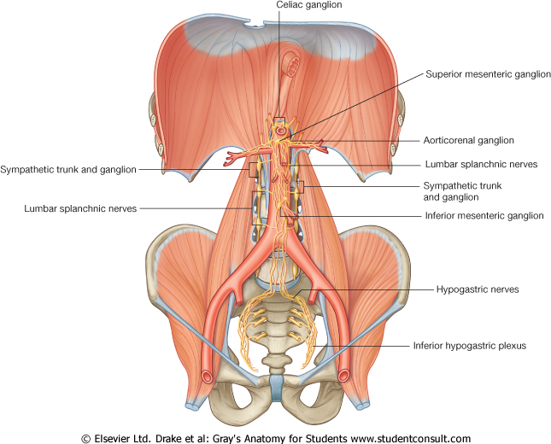
Sympathetic Ganglia of the Abdomen
Celiac (T5-T9)
  Distal esophagus, stomach, proximal duodenum, liver, gall bladder, spleen, portions of pancreas
Sup. Mesenteric (T10-T11)
  Distal duodenum, portions of the pancreas, jejunum, ascending colon, proximal 2/3 of the transverse colon
Inf. Mesenteric (T12-L2)
  Distal 3rd of the transverse colon, descending colon, sigmoid colon, rectum

Slide 79
Sacral Rocking
Place the fingertips of one hand at the ILA of the sacrum
Place the fingertips of the other hand at the ipsilateral sacral base
Exert alternate pressure in an anterior direction with fingertips
S2-4 supply parasympathetics to the distal colon

Slide 80
Case Summary
Assessment
  Abdominal Pain
  IBS
  Somatic Dysfunction Thoracic, Cervicals, Abdomen
Plan
  Discussed lifestyle changes with patient
    Increased fiber, avoid dairy and gluten
  Consider CBT if not improving
  Loperimide PRN diarrhea
  Osteopathic Manipulation to 3-4 body regions
    E&M code 99213-25
    CPT code 98926

Slide 81
Time management tips
Incorporate the mesenteric release and/or linea alba release into your abdominal exam
Educate your patient while you are doing other techniques such as paraspinal soft tissue or OA/Sacral release
Doing OMT is a win/win!!
  Patients appreciate extra hands-on care
  You get reimbursed for a medical procedure

Slide 82
OMM codes
Somatic Dysfunction
Osteopathic Manipulation
  Cranial- 789.0 (M99.00)
  Cervical- 789.1 (M99.01)
  Thoracic- 789.2 (M99.02)
  Lumbar- 789.3 (M99.03)
  Sacrum- 789.4 (M99.04)
  Hip/Pelvis- 789.5 (M99.05)
  Lower Extremity- 789.6 (M99.06)
  Upper extremity- 789.7 (M99.07)
  Rib- 789.8 (M99.08)
  Abdomen/other- 789.9 (M99.09)
  98925: 1-2 body regions
  98926: 3-4 body regions
  98927: 5-6 body regions
  98928: 7-8 body regions
  98929: 9-10 body regions
  25 modifier on E&M code for separately identifiable service

Slide 83
Research
Hundscheid, et al. Treatment of IBS with osteopathy: results of a randomized, controlled pilot study. J Gastroenterol Hepatol. 2007 Sep;22(9):1394-8.
  20 patient received OMT q 2-3 weeks
  19 received standard of care: dietary alteration and symptomatic medications
Results
  Treatment group:13/19 (68%) patients in the Osteopathic group noted definite overall improvement in symptoms at 6 months. And 5% were free of symptoms at end of study.
  Standard of care group: 3/17 (18%) patients in the standard care group noted definite improvement.
  Overall, patients treated with osteopathy did better with respect to symptom score and QOL.

Slide 84
Post-test Question
The crura of the diaphragm attach to what anatomic structures?
  The lower thoracic vertebrae
  The upper lumbar vertebrae
  Ribs 11 and 12
  The Sternum

Slide 85
Post-test Question
This nerve is primary responsible for the relaxation of the lower esophageal sphincter?
  Hypoglossal
  Vagus
  Glossopharyngeal
  Phrenic
  Spinal Accessory

Slide 86
Post-test Question
A patient presents with complaints of “heartburn”. Where would you expect somatic dysfunction of the spine related to the sympathetic innervation for this patient.
  OA
  T1-4
  T5-9
  T10-L2
  S2-4

Slide 87
Post-test Question
Sympathetic nervous system stimulation leads to which of the following actions in the intestines?
  Vasodilation
  Relaxation of sphincters
  Diarrhea
  Decreased persistalsis

Slide 88
Post-test Question
Which of the following is a correct ICD-10 code for somatic dysfunction?
  98927
  789.3
  M99.2
  25 modifier
  99213

Slide 89
Contact information
Ryan Seals DO
Ryan.Seals@unthsc.edu
Office: UNT Patient Care Center
  855 Montgomery- 6th floor OMM Clinic
  817-735-2235

