Slide 1
Upper Extremity Somatic Dysfunction
DSA

Slide 2
Objectives
Be able to provide differential diagnosis, treatment, management, and explanation of common and important causes of upper extremity pain (this will primarily be covered in your systems course) Shoulder pain (Adhesive capsulitis) Elbow pain (Lateral and medial epicondylitis) Wrist pain (Carpal Tunnel syndrome) Identify the role of somatic dysfunction in the above disorders and be able to diagnose somatic dysfunctions of the Clavicle (including sternoclaviular and acromioclavicular joints) Glenohumeral joint Radial head Metacarpals Tender points in muscles of the upper extremity Apply the 5 models of Osteopathic Medicine to address the above clinical presentations

Slide 3
Case 1
A 55 year old female complains of right shoulder pain. She denies injury and states it has been progressively getting worse for weeks. PMH is notable for DM and hypothyroidism. You have a difficult time performing the shoulder exam because every movement seems to cause pain. You also note restricted active and passive ROM especially in external rotation.

Slide 4
Physical Exam
The physical exam is very difficult to perform.
On active ROM you find
  Abduction: Right 75 degrees; Left 160 degrees
  Flexion: Right 90 degrees; Left 180 degrees
  Ext. Rotation: Right 30 degrees; Left 75 degrees
    When arm abducted to 90 degrees with elbow at 90 degrees
  Int. Rotation: Unable to place right arm behind small of her back; left arm can reach small of her back
Passive ROM
  Similar findings to active ROM
Tenderness noted along deltoid, teres minor, and subscapularis muscles

Slide 5
Adhesive Capsulitis
“frozen shoulder”
Insidious onset of stiff, painful shoulder with or without inciting injury
Significantly decreased GH ROM - Active and Passive
  External Rotation up to 50%
  Internal Rotation (unable to touch thumb to belt)
  Abduction less than 90 degrees
  Less than 135 degrees of flexion
Inflammation
Fibrous changes in periarticular soft tissue
Decreased joint volume - confirmed by arthography
Osteoarthritis- also causes loss of active and passive ROM

Slide 6
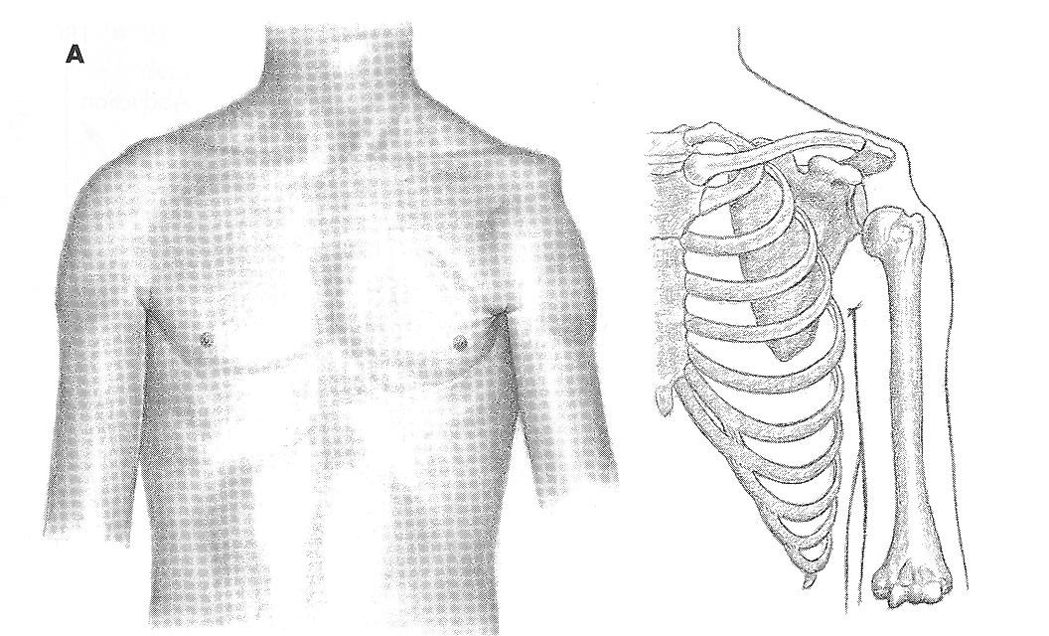
Factors Predisposing to Development of Adhesive Capsulitis
Immobility (side effect of basic treatment at times)-Trauma, CVA
40-60 years of age
Female
Diabetes (up to 10 times more prevalent than non-DM)
Thyroid disease
Humeral lesions, eg. OA
Personality disorder
Autoimmune disease

Slide 7
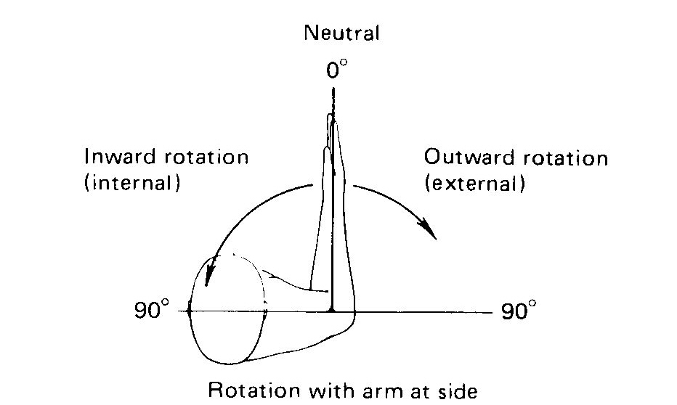
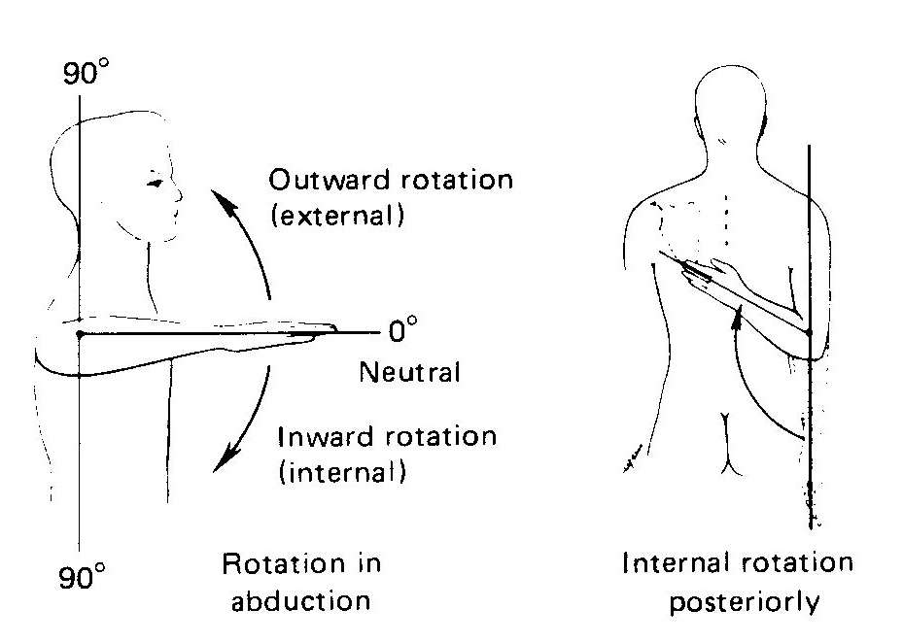
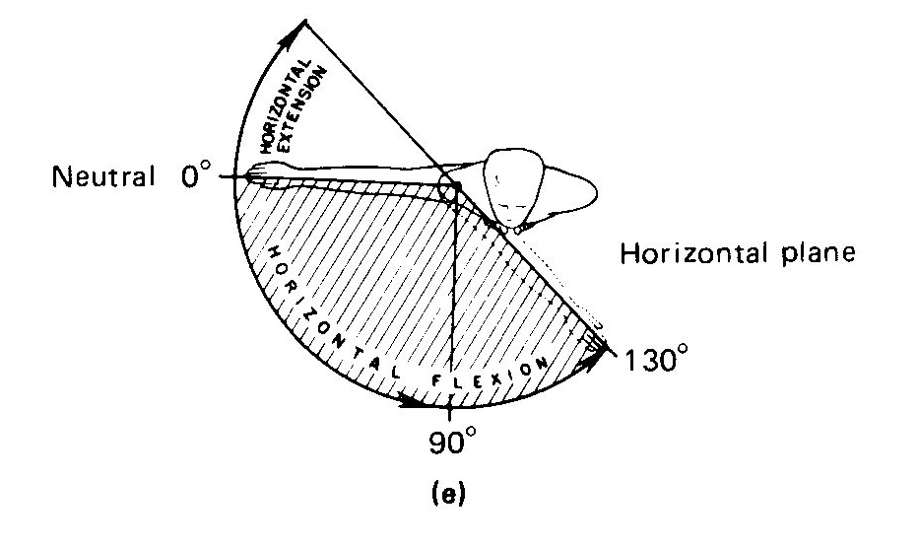
ROM (continued)

Slide 8
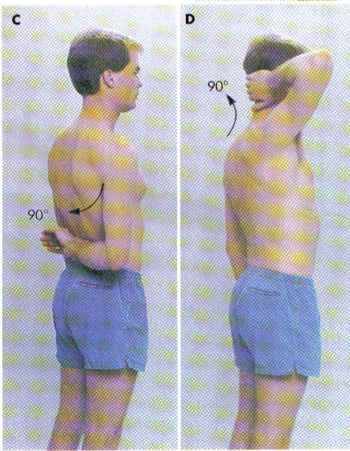
Range of Motion (continued)
Please note that normal ROMs vary according to certain sources, but the main point is to document a baseline, and measure progress during treatment
Compare to patients “normal” side

Slide 9
Adhesive Capsulitis
Treatment
  Aggressive ROM exercises
    Physical Therapy
    OMM- Spencer techniques
  Some people recommend corticosteroid injections to decrease inflammation
  Most will get better with time on their own
    From months to several years

Slide 10
Case
A patient presents with left shoulder pain. She recently started CrossFit 2 months ago, but denies any specific injury. On exam she has pain with the empty can test, but no weakness. What is your diagnosis?

Slide 11
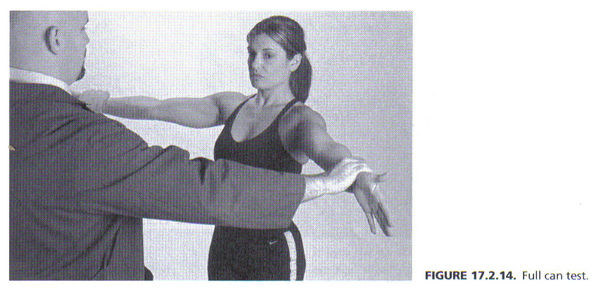
Rotator Cuff Testing
Full Can Test- Pt. resists downward pressure by examiner
Pos. test: Weakness, pain, or dropping of the arm, indicating supraspinatus tendinitis or tear (the degree of weakness suggests the severity of the tear).
Empty Can Test- Not as sensitive as Full Can.
PITFALL: Not Adducting 30 degrees, testing both arms at wrists

Slide 12
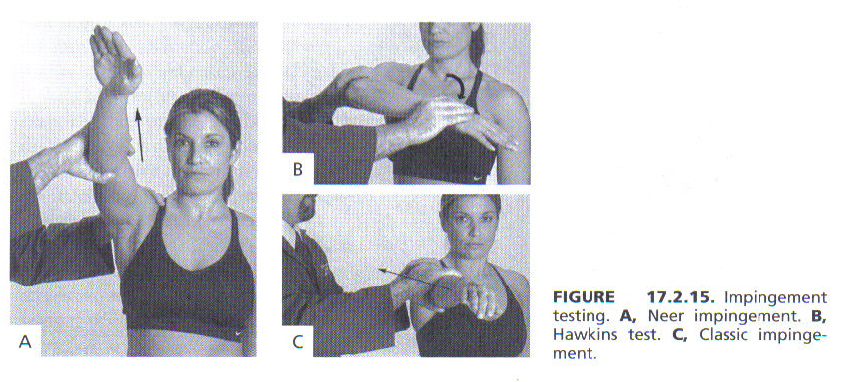
Rotator Cuff Impingement
  Shoulder pain worse with overhead motions due to impingement of rotator cuff tendons under the acromion.
Neer Impingement Test- Examiner stabilizes pt’s. shoulder on top, and then passively forward flexes the arm above shoulder level to a fully flexed position.
Pos. test-Pain provoked

Slide 13
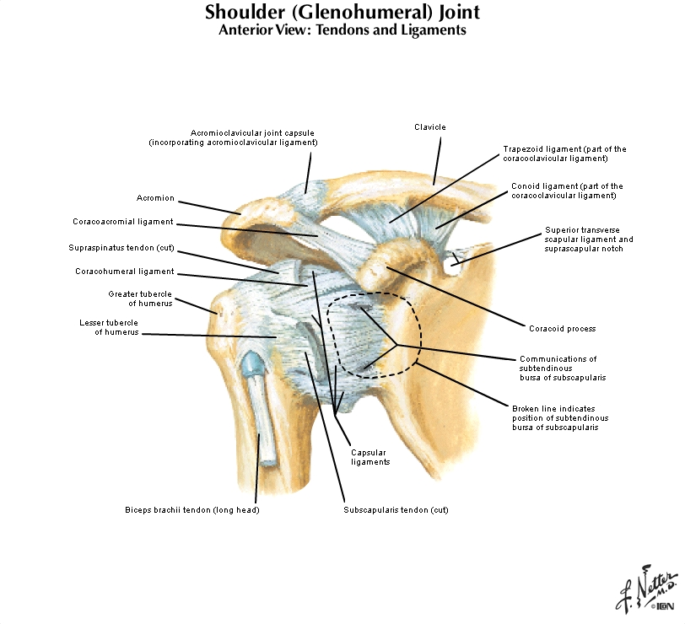

Slide 14
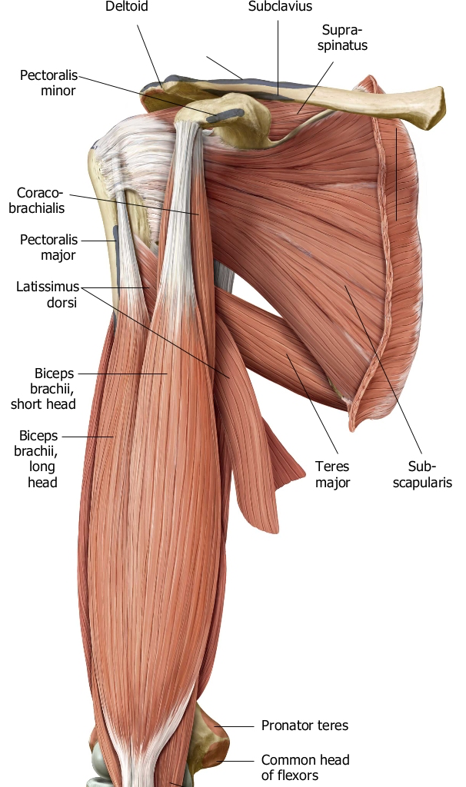
Osteopathic Considerations
Remove mechanical restrictions around shoulder joint
  Treat rotator cuff muscles
  Consider Latissimus, Pec Minor, Biceps, clavicle etc.

Slide 15
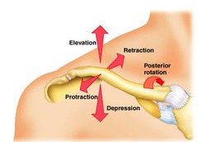
Clavicular Motion
Sternoclavicular Motions:
  Superior/ Inferior
  Anterior/ Posterior
  Internal/ External Rotation
SC Motion testing-
  Have patient shrug shoulders while you monitor SC joint motion- determine if superior or inferior somatic dysfunction
  Internal/external rotation
Acromioclavicular Motions:
  Internal/external rotation
  Superior/Inferior glide

Slide 16
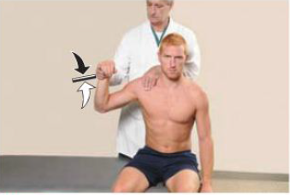
OMM for Clavicle
Remember to assess clavicular motion at the SC and AC joints for internal and external rotation. Treat directly with muscle energy.

Slide 17

Shoulder Exam Video

Slide 18
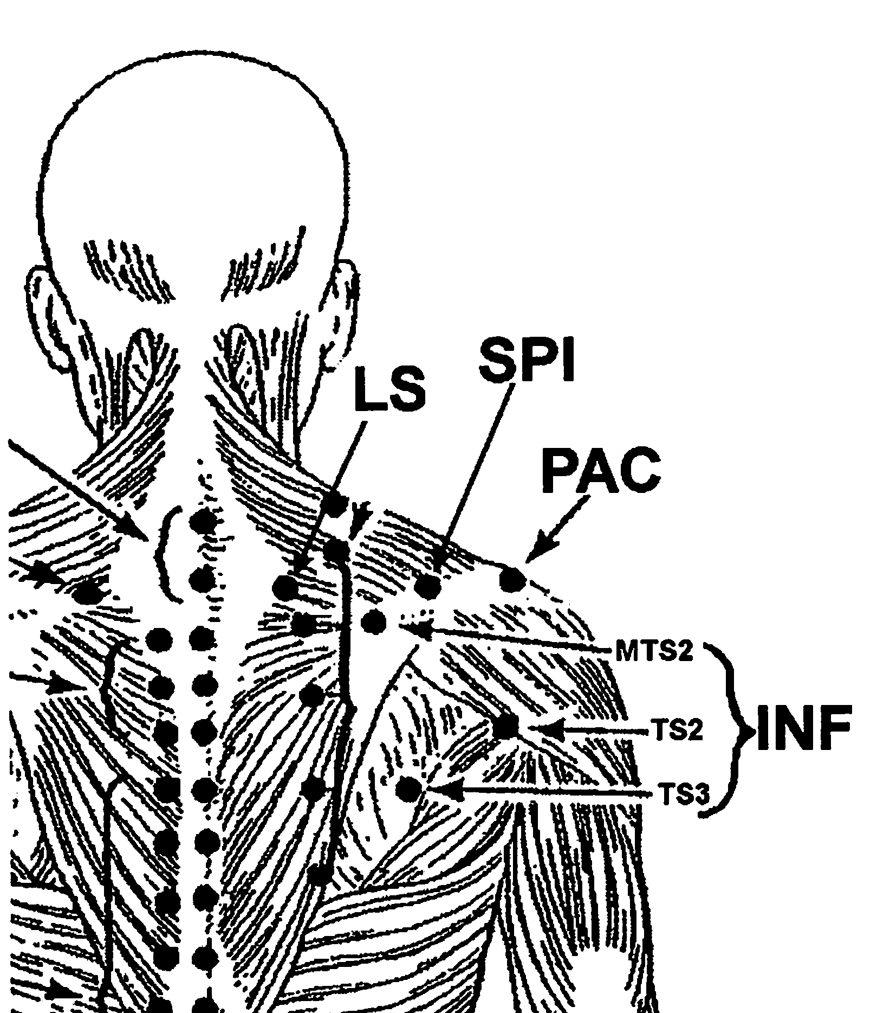
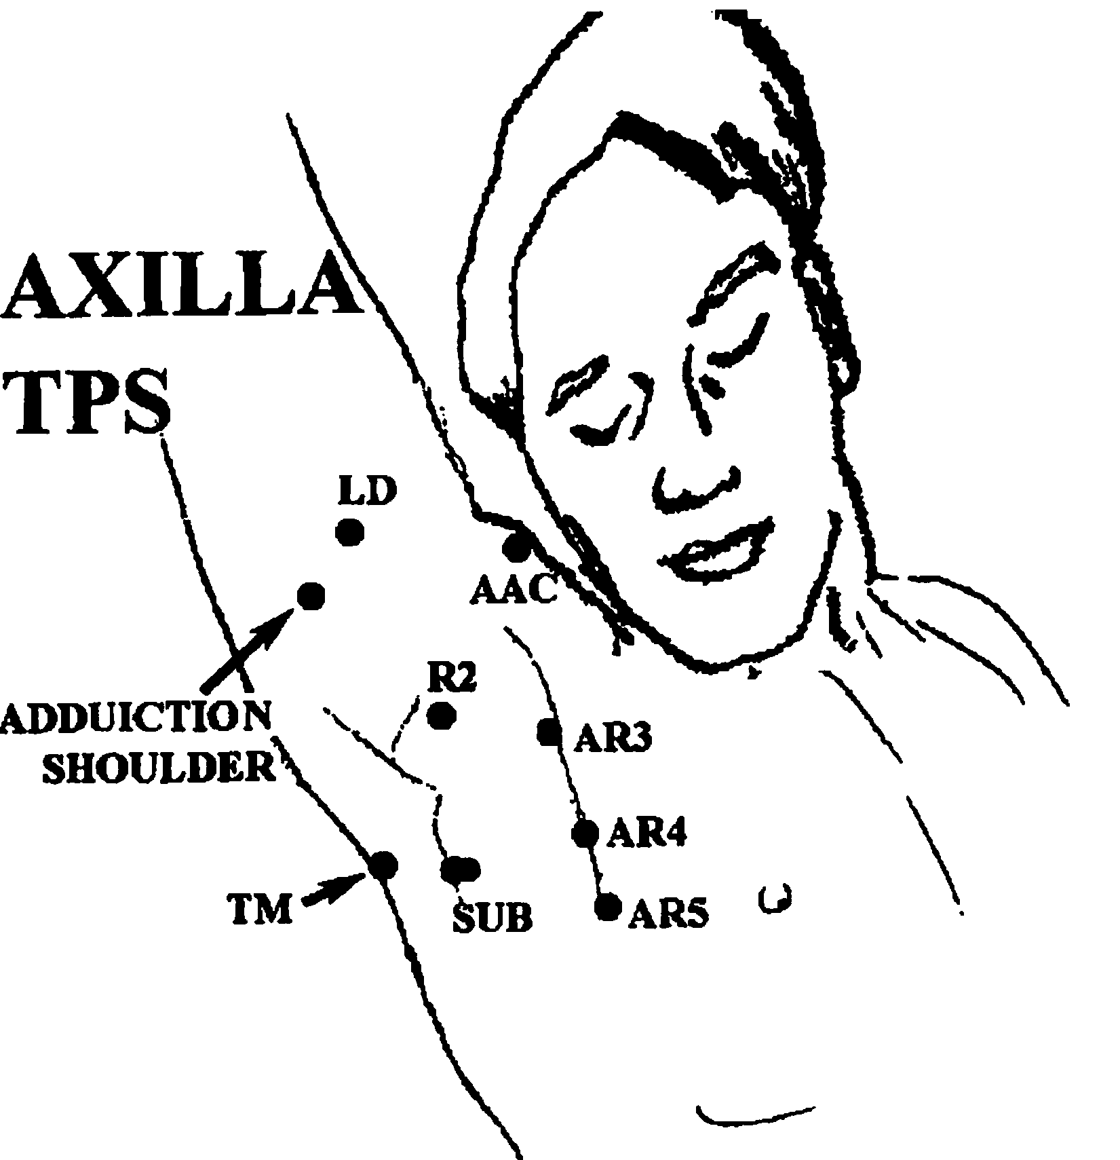
Counterstrain

Slide 19
Case
A left-handed 56 year-old woman with left sided neck and shoulder pain. Occasionally, the pain radiates from her neck to her elbow and hand in a a vague distribution. She also complains of a “tingling” sensation. It began after painting her ceiling last week.

Slide 20
Exam
Exam: Tender point at insertion of Ant. Scalene on left, C3 flexed and rotated right, rib 1 elevated on left. She has full AROM shoulders without impingement.
Neuro: Reflexes and strength are normal
Right radial pulse diminishes with arm abduction and external rotation
Cervical spine xrays-unremarkable.

Slide 21
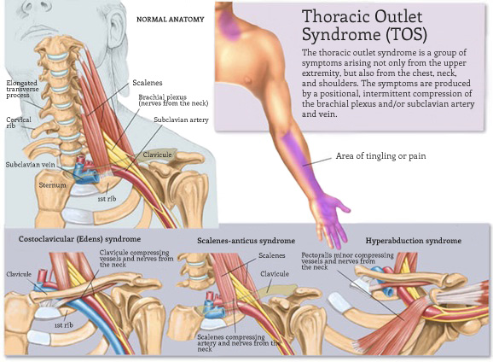

Slide 22
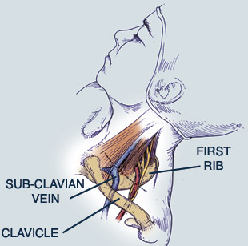
Thoracic Outlet Syndrome
Typically presents with pain in the back of the shoulder region into the upper extremities. May be accompanied by numbness, tingling, weakness, cooling, swelling or discoloration.
Compression of subclavian artery or vein, or brachial plexus, usually C8 and T1
Due to dysfunction of upper ribs, clavicle or upper thoracics; cervical ribs; XS tension in middle and anterior scalenes; abnormal insertion of pec minor

Slide 23
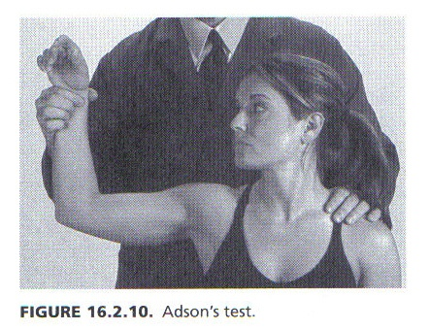
Adson’s Test
The examiner palpates the radial pulse on the affected arm with the arm at pt’s. side.
As pulse is monitored, examiner moves arm into abduction and external rotation.
Pt. takes a deep breath & turns head toward the raised arm.
Positive test: marked diminution or loss of pulse.
Indicates: Subclavian artery compression by cervical rib and/or scalene muscles i.e. Vascular thoracic outlet syndrome.

Slide 24
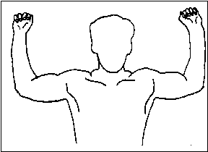
Roos Test
Have the patient abduct and externally rotated their arms to 90 degrees then open and close their hands rapidly for 3 minutes. The test is positive if the patient experiences pain, numbness, paresthesias, or fatigue.
Roos Test

Slide 25
Causes
Anatomic
  Cervical ribs- 1% of population
  Congenital fibromuscular bands are noted in as many as 80% of patients with neurologic TOS
  Transverse process of C7 is elongated
Trauma/Repetitive Activity
Entrapment in costoclavicular space
Somatic Dysfunction: Cervical spine, scalenes, upper ribs, clavicle, pec minor, upper thoracic spine, etc.

Slide 26
TOS Treatment
OMT (ribs, scalenes, clavicle, pec minor, cervical and thoracic vertebra)
PT
EMG to evaluate for neurogenic etiology
Surgery Treatment:
-Decompression depending on the cause
-Often 1st rib is removed
-Cervical rib removed
-Release anterior and middle scalenes

